Slide 1
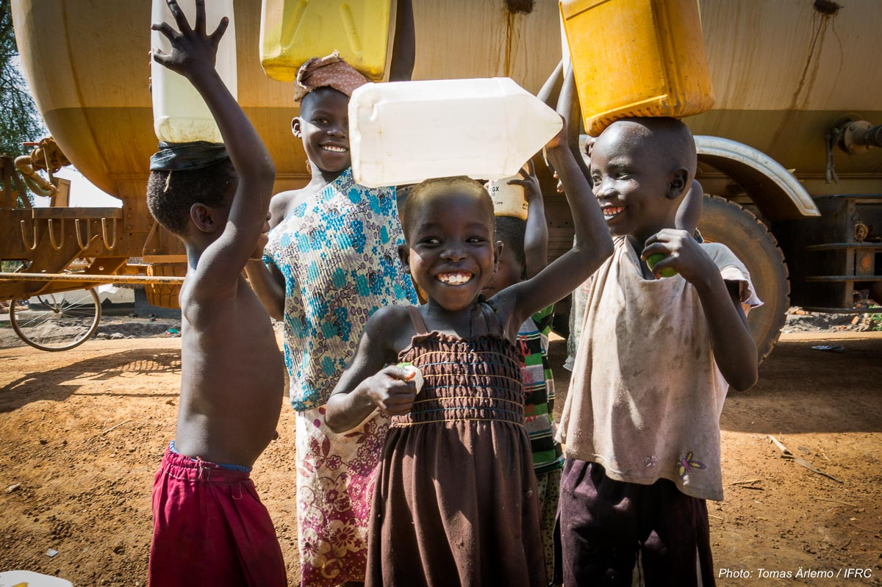
East Africa DM platform
ADMAG meeting
5-7 September 2018
Nairobi, Kenya
Children in Imvepi settlement Northern Uganda. Thomas Arlemo (IFRC)

Slide 2
Background to DM platform initiative
Did exist one network before, 10 year ago
Came out strongly on DM meeting 2017
Stronger DM team doing more
Funding not a problem
ADMAG

Slide 3
Objectives
Link NS together across Eastern Africa (not only cluster)
Promote and share good examples and learn together
Provide a EA platform for movement coordination and cooperation

Slide 4

Agenda
Activities DM platform
Online platform
Peer-to-Peer
Annual DM meeting
Webinar
Quarterly PNS meeting on DM
Cash Coordination
Green response
Preparedness
Ethiopia (IFRC)
Notes:
Introduction of humanitarian situation and operations
Overview of the Ops team, roles and responsibilities and funding situation
Overview of current operations, challenges and funding coverage
Presentation of some good examples from Operations in regard to communication, PMER
Way forward – discussion. How to enhance communication and coordination and innovative approach.

Slide 5
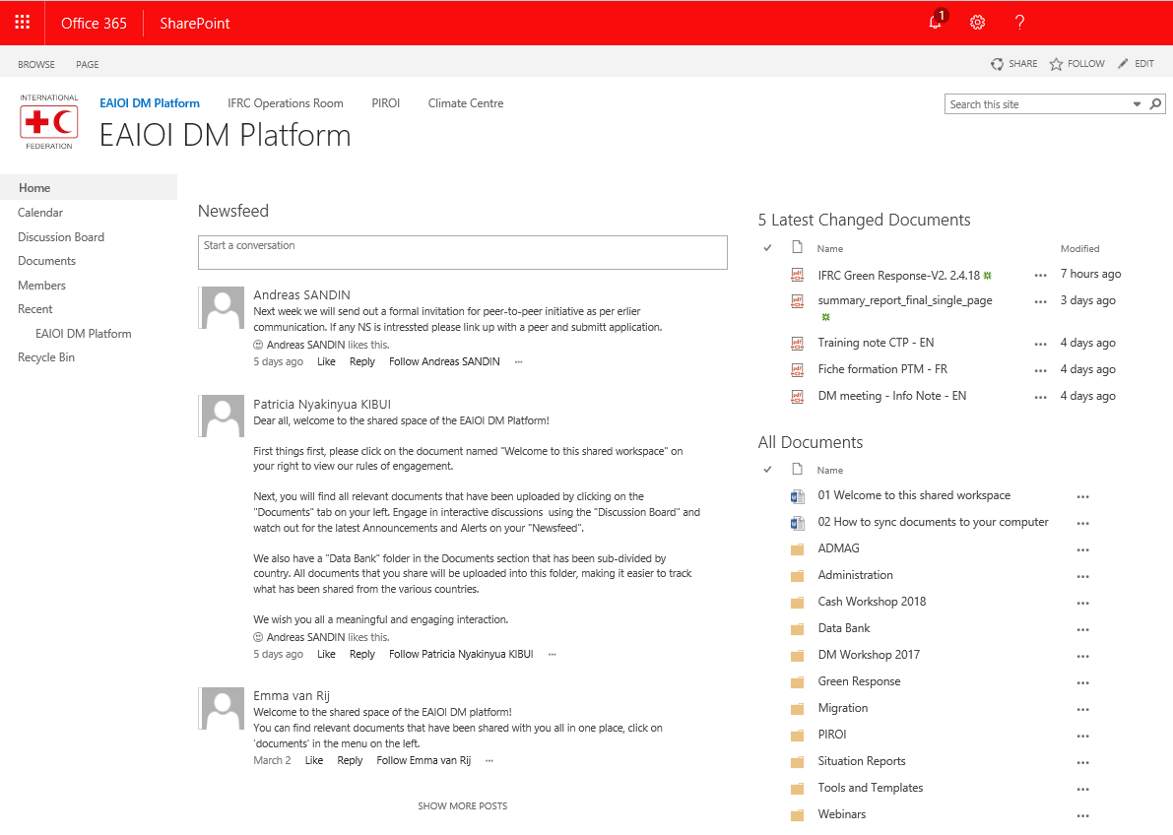

Slide 6
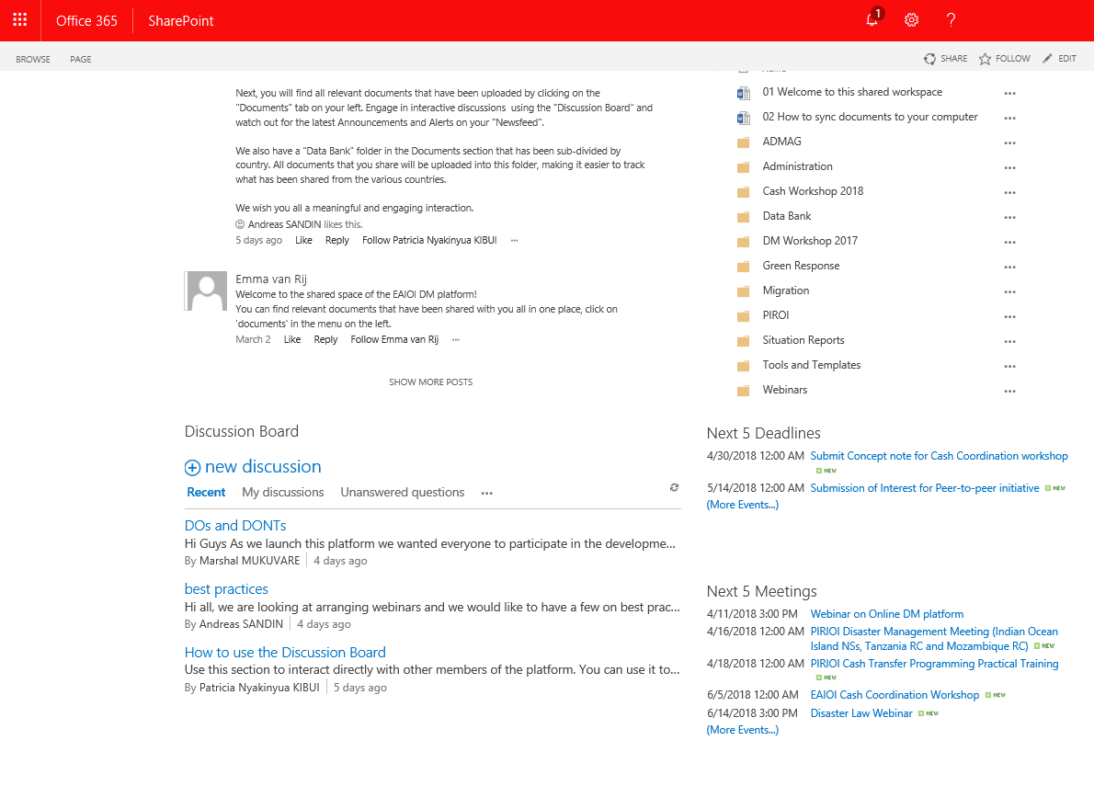

Slide 7
Activities DM platform
Peer-to-peer BRCS/TRCS and DRC/URCS/RRCS
Annual DM meeting in Oct (preparedness)
Webinars
Focus on Preparedness
Job rotation program
Ethiopia (IFRC)
Notes:
Introduction of humanitarian situation and operations
Overview of the Ops team, roles and responsibilities and funding situation
Overview of current operations, challenges and funding coverage
Presentation of some good examples from Operations in regard to communication, PMER
Way forward – discussion. How to enhance communication and coordination and innovative approach.

Slide 8
Activities DM platform
Cash Coordination and strategy workshop
- Working group
- Plan of action with budget
Green Response
- Pilot together with Norcross
- Chinese proposal
Ethiopia (IFRC)
Notes:
Introduction of humanitarian situation and operations
Overview of the Ops team, roles and responsibilities and funding situation
Overview of current operations, challenges and funding coverage
Presentation of some good examples from Operations in regard to communication, PMER
Way forward – discussion. How to enhance communication and coordination and innovative approach.

Slide 9
Thank you
© International Federation of Red Cross and Red Crescent Societies, Geneva, 2017.
Add any information to copyrighted materials here.
Any part of this presentation may be cited, copied, translated into other languages or adapted to meet local needs without prior permission from the International Federation of Red Cross and Red Crescent Societies, provided that the source is clearly stated. Requests for commercial reproduction should be directed to the IFRC Secretariat at secretariat@ifrc.org
All photos used in this presentation are copyright of the IFRC unless otherwise indicated.
This presentation was written and developed by (EA Emergency Operations Team) and produced in (June 2017).
This presentation and relevant resources are available on FedNet at fednet.ifrc.org

